Slide 1
Formal Verification of Digital Systems
Model Checking
Suraj Sindia
11 April 2012

Slide 2
What is Model Checking?
Are we checking these kind of models…?
Unfortunately, no!

Slide 3
Verification of Circuits
Simulation based verification
Applying a known stimulus to a circuit, and ensuring that all its outputs meet pre-determined performance criteria
Logic simulation – E.g.: ModelSim
Timing simulation – E.g.: HSPICE
Historically most prevalent form of verification
Time for verification grows exponentially with number of inputs
For most real designs, needs application of 60-70% of all input vectors to validate a circuit’s functionality
This implies there is no 100% guarantee that a design is correct!

Slide 4
Verification of Circuits
Formal verification
Ensuring that a circuit satisfies (or does not satisfy) all its desired (or undesired) behavior by building a logical formalism – an abstraction – for the circuit being tested
The behavior being tested for, is also expressed in the same abstract form
Some examples: equivalence checking, model checking, static timing analysis (most of us are oblivious to the fact that this is a formal scheme for ensuring timing correctness of a circuit)

Slide 5
Formal Verification of Circuits
Primarily is used in two flavors today –
Equality checking
Two implementations of a circuit are formally compared to check if they both are equivalent
For example: Comparing RTL vs. gate level netlist of a design
Formality from Synposys
Model checking
Some behavior of the circuit is abstracted and the following question is posed:
“Does the circuit satisfy this behavior?”
Focus of this and next class

Slide 6
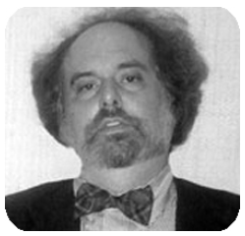
Inventors of Model Checking
ACM Turing award citation
E. Allen Emerson, UT Austin
Joseph Sifakis, CNRS Grenoble, France

Slide 7
Abstractions for Model Checking
Linear Temporal Logic (LTL)
Computation Tree Logic (CTL)
In this and next class
We will learn these two languages
Use them to specify properties, and verify finite state machines (FSM)

Slide 8
Propositional Logic - Basics
AND (˄)
OR (˅)
NOT (¬)
IMPLICATION (→)
BI-CONDITIONAL (↔)

Slide 9
Summary of Truth Tables
p | q | p ∧ q | (p ∨ q) | p → q | p ↔ q
T | T | T | T | T | T
T | F | F | T | F | F
F | T | F | T | T | F
F | F | F | F | T | T

Slide 10
LTL for Model Checking: Example 1

Slide 11
LTL for Model Checking: Example 2

Slide 12
LTL for Equivalence Checking

Slide 13
Computation Tree Logic (CTL)

Slide 14
CTL State Operators: Quick Illustration
Fp – p holds in some future state
Gp – p holds globally in future states
~p
~p
~p
~p
~p
p
x
s₀
s₁
s₂
s₃
s_{n}
s_{n+1}
s_{n+2}
~p
~p
~p
p
p
p
p
s₀
s₁
s₂
s₃
s_{n}
s_{n+1}
s_{n+2}
x
denotes don’t care

Slide 15
CTL State Operators: Quick Illustration
Xp – p holds in next state
pUq – p holds until q
~p
p
x
s₀
s₁
s₂
p
p
p
q
q
x
x
s₀
s₁
s₂
s₃
s_{n}
s_{n+1}
s_{n+2}
x
denotes don’t care

Slide 16
CTL State Operators: Quick Illustration
pWq – p holds until q
p
p
p
pvq
pvq
x
x
s₀
s₁
s₂
s₃
s_{n}
s_{n+1}
s_{n+2}
x
denotes don’t care

Slide 17
CTL Path Operators
A(arg) – Along all paths starting at state s₀ arg is True.
s₀
Example: AGp

Slide 18
CTL Path Operators
E(arg) – Along some path starting at state s₀ arg is True.
s₀
Example: EGp

Slide 19
References
Logic in Computer Science – Modelling and Reasoning about Systems
2nd edition of this book by M. Huth and M. Ryan and published by Cambridge press.
Covers all the aspects of LTL and CTL, with several nice examples, that we studied over the last two classes.
Warning: Can be overwhelming in the beginning!
Comprehensive Functional Verification – The Complete Industry Cycle
Authored by B. Wile, J. C. Goss, W. Roesner and published by Elsevier.
50% of the book is on simulation based verification and the rest on formal verification.
Best practices for verifying large and complex industrial designs are discussed.
http://www.design-reuse.com/articles/2287/survey-compares-formal-verification-tools.html
Survey by Lars Philipson. Gives a list of currently available equivalence checkers and model checkers.

Slide 20
Doodles Drawn on Paper

Slide 21
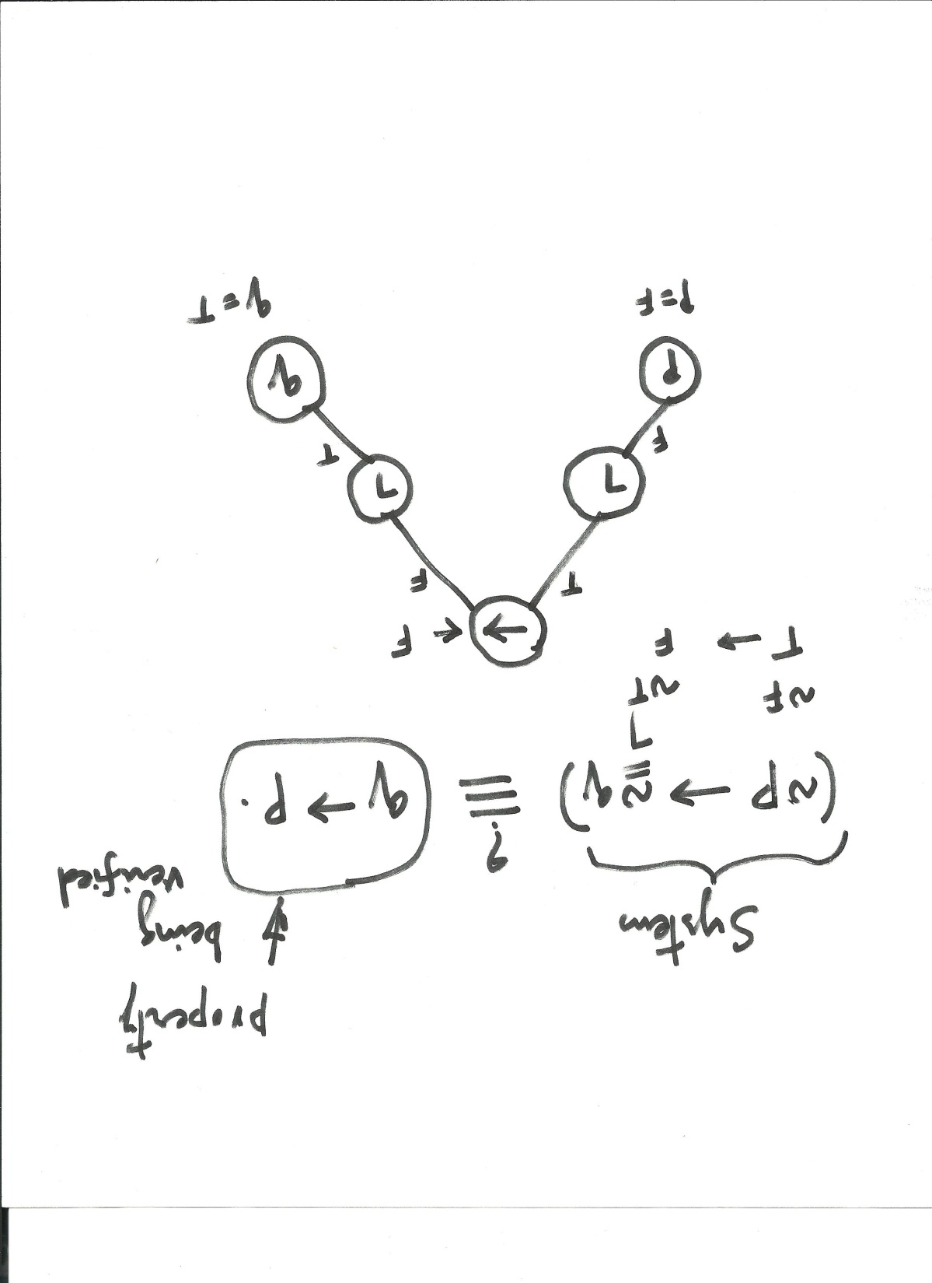
Justifications on a Parse Tree for Checking Equivalence of Two Boolean Functions

Slide 22
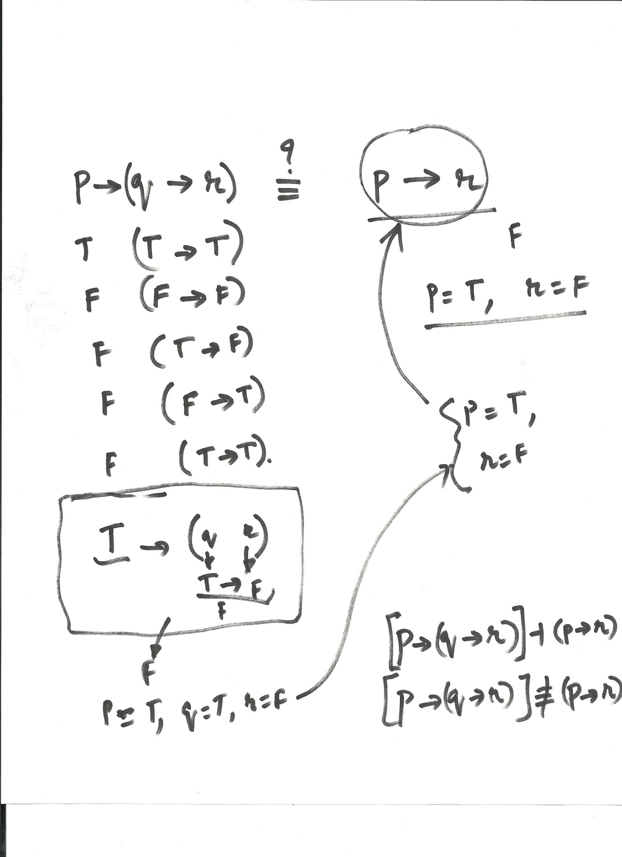
Equivalence Checking

Slide 23
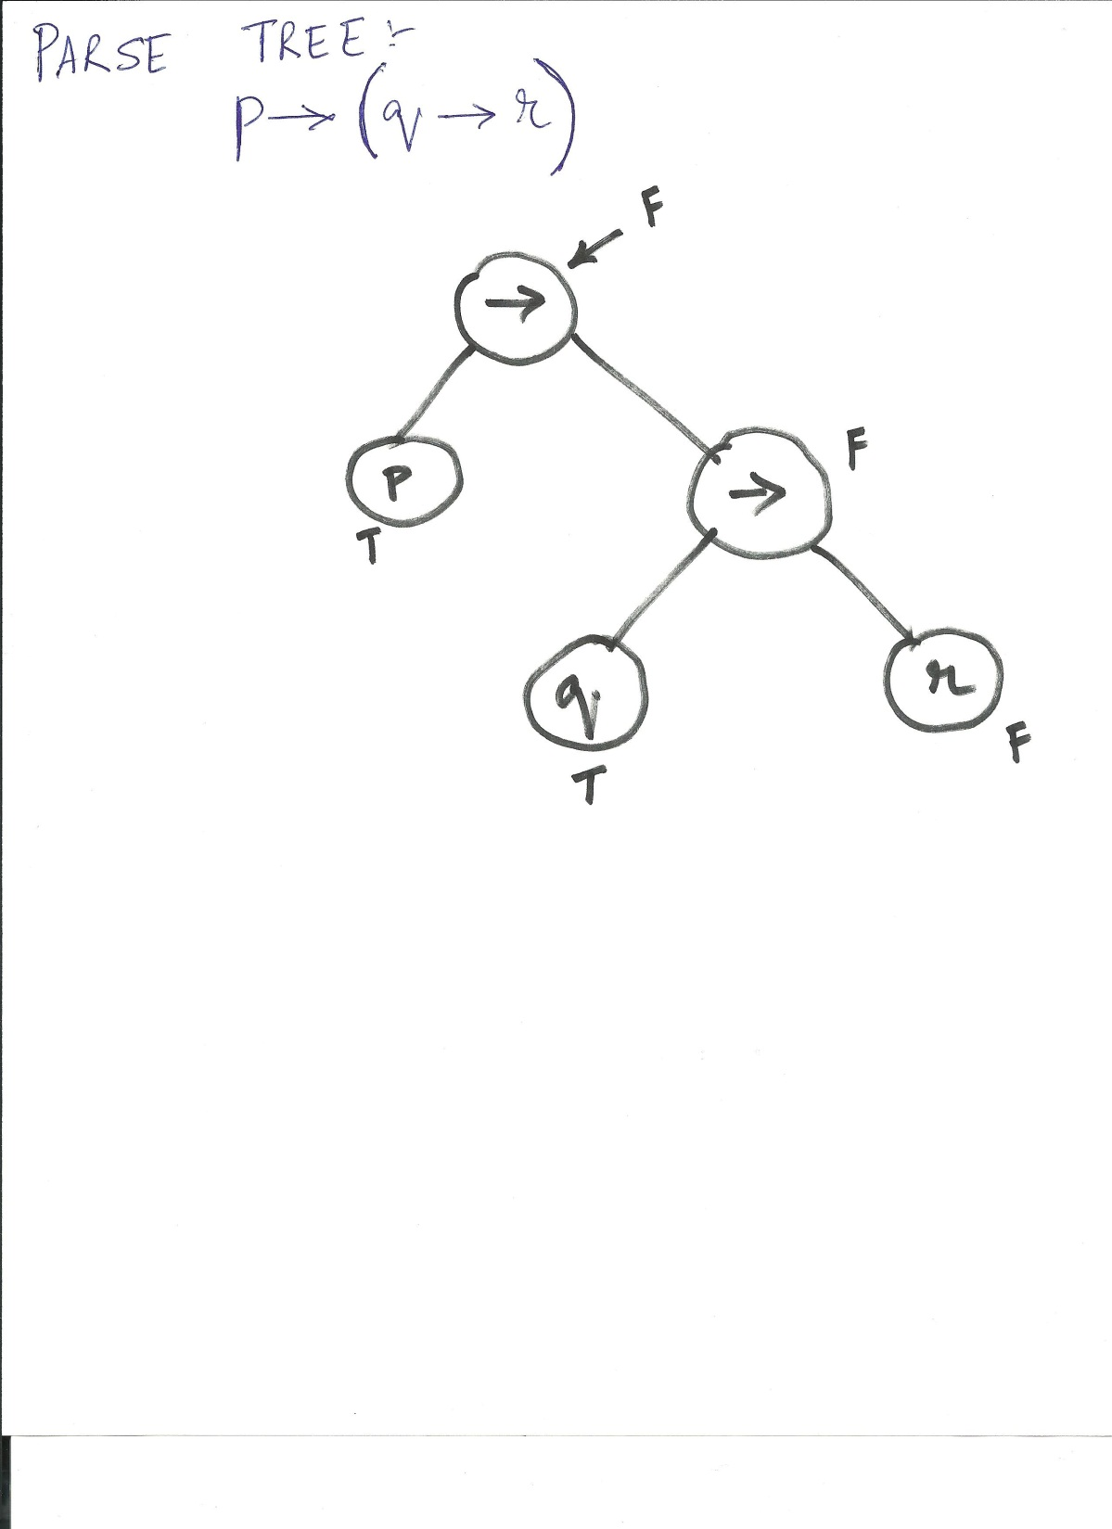
Parse Tree for a LTL Formulae

Slide 24
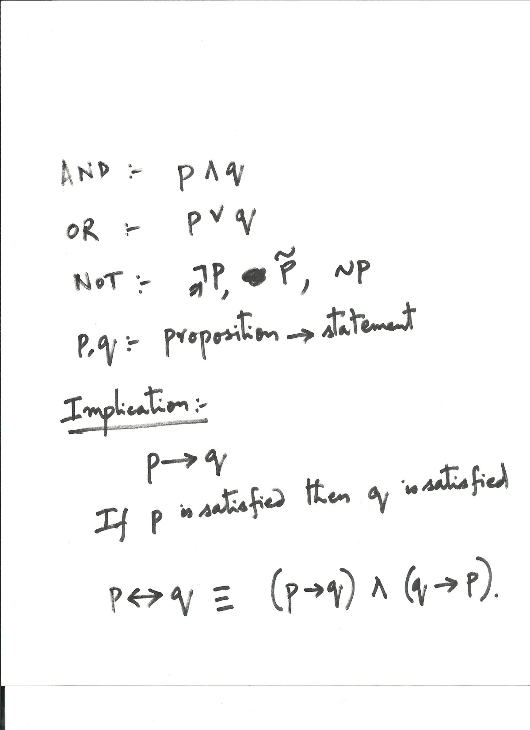
Understanding Implication in LTL

Slide 25
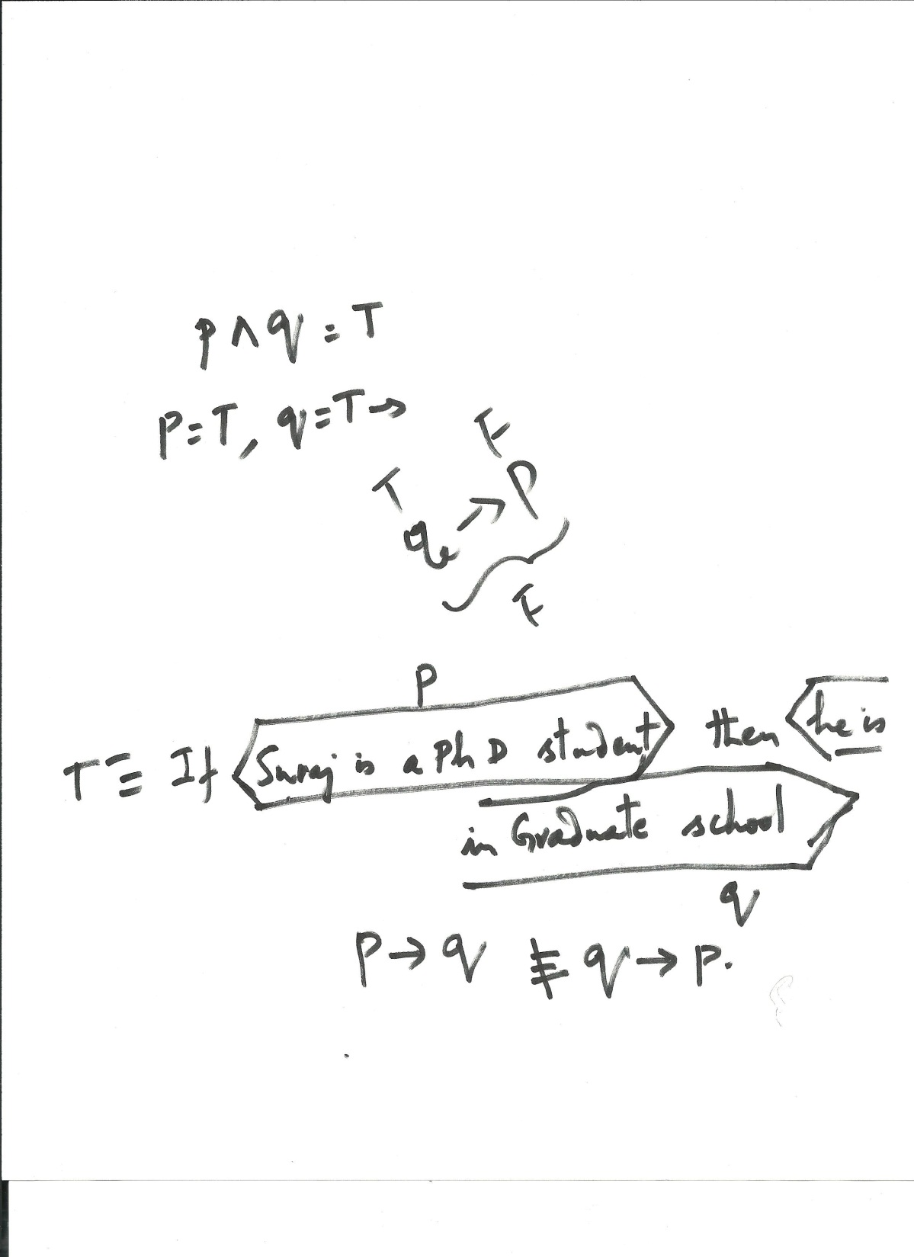
Verbal Example of an Implication
See that converse is not true.

